Slide 1

Mathematical Modeling of Six Database-Derived Gene Regulatory Networks Identifies Key Regulators and Network Properties Controlling the Early Response to Cold Shock in Saccharomyces cerevisiae
Brandon Klein
Department of Biology
Loyola Marymount University
βββ Pacific District Conference
March 17, 2018

Slide 2
Outline
Yeast quickly respond to cold shock by changing gene expression, although the transcription factors regulating this cold response have not been established.
GRNmap successfully models gene regulatory network parameters from microarray data using differential equations.
Comparative analysis of six database-derived networks reveals conserved properties of the network controlling the cold shock response in yeast.

Slide 3
Outline
Yeast quickly respond to cold shock by changing gene expression, although the transcription factors regulating this cold response have not been established.
GRNmap successfully models gene regulatory network parameters from microarray data using differential equations.
Comparative analysis of six database-derived networks reveals conserved properties of the network controlling the cold shock response in yeast.

Slide 4
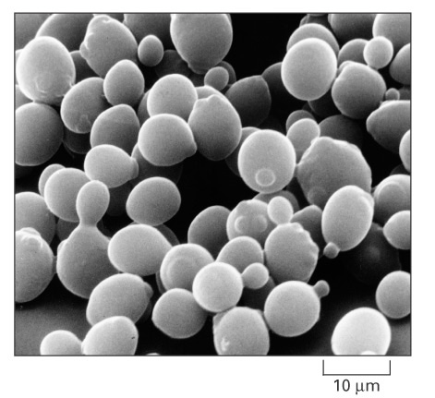
Budding Yeast, Saccharomyces cerevisiae, is
an Ideal Model Organism for Systems Biology
Small genome of ~6000 genes
Molecular genetic tools and datasets widely available
As a eukaryote, serves as an important model for human cells
Alberts et al. (2004)
Notes:
01_32_model eucaryote.jpg
Condense this + next slide.

Slide 5
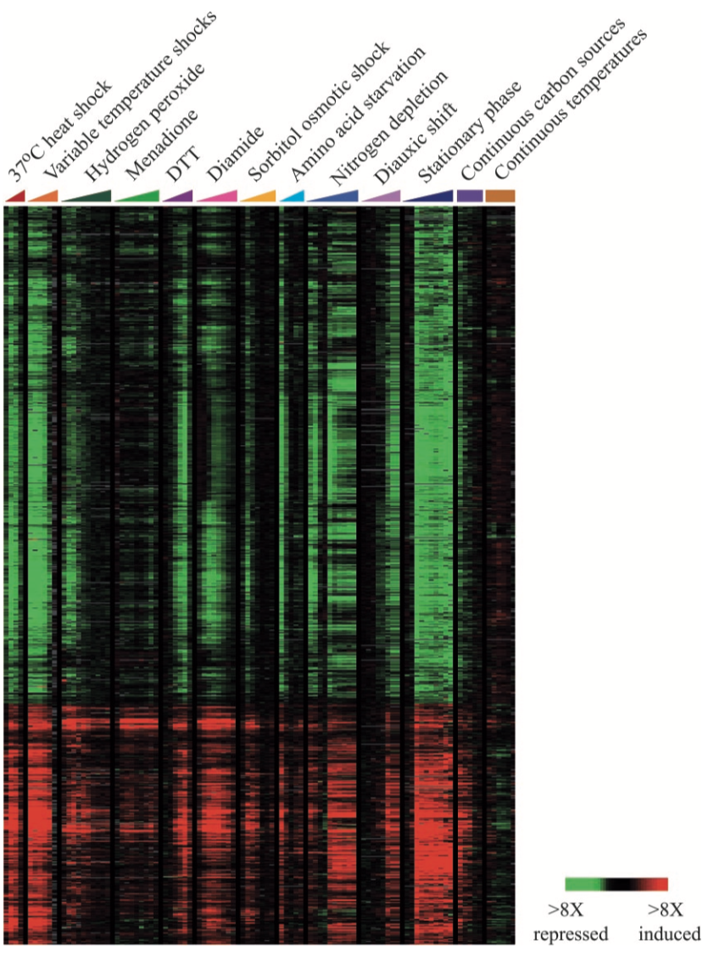
Yeast Respond to Environmental Stress by Changing Gene Expression
Manipulation of incubation temperature or growth media is easily performed.
Genome-wide transcriptional responses are characterized through DNA microarray experiments.
Previous work exposing yeast to various stressors shows a General Environmental Stress Response (ESR).
The ESR is dependent on the transcription factors YAP1, MSN2, and MSN4.
Gasch et al. (2000)
Notes:
Variable temperature shocks = various permutations of heat shock (i.e. different starting temps → 37C).

Slide 6
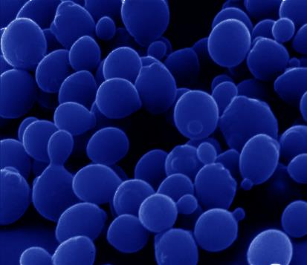
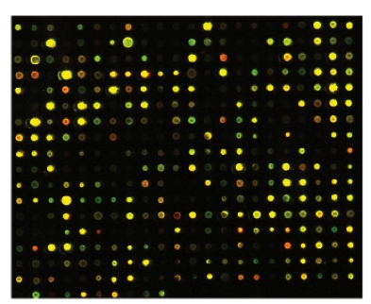
Cold Shock is an Environmental Stress that is Not Well-Studied test
10-18°C
Impaired translation due to mRNA and ribosome instability, and decreased membrane fluidity.
~25% of the genome is involved in the transcriptional response, with one-third of genes encoding ribosomal proteins.
Previous studies have shown that the cold shock response can be divided into an early and late response.
ESR genes are induced in the late response through MSN2/4 activity.
No “canonical” factor responsible for early response.

Slide 7
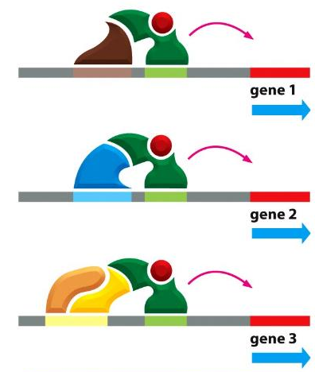
Regulatory Transcription Factors Control Gene Expression by Binding to DNA Sequences
Activators increase gene expression.
Repressors decrease gene expression.
Transcription factors are themselves proteins that are encoded by genes.
In yeast, transcription factors regulate genes through combinatorial control.
Alberts et al. (2014)

Slide 8
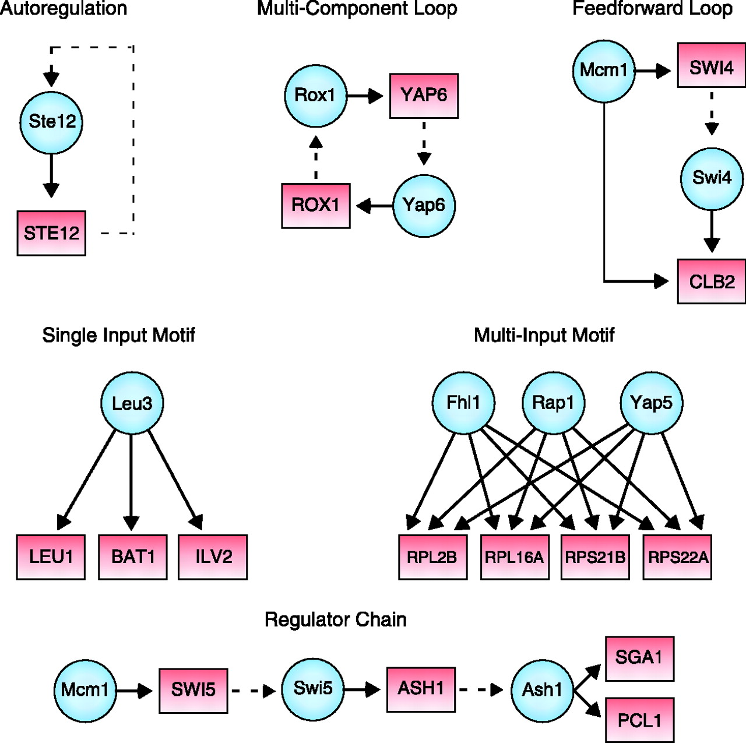
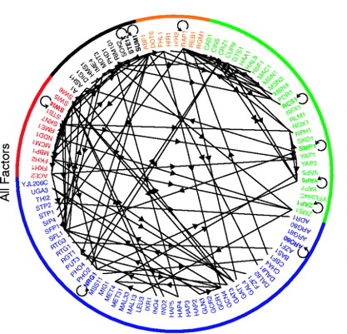
Transcription Factors Regulate One Another, Forming Gene Regulatory Networks
Gene Regulatory Network (GRN)
of 106 Transcription Factors
Common Network Motifs
Lee et al. (2002)

Slide 9
Transcription Factors Regulate One Another, Forming Gene Regulatory Networks
Gene Regulatory Network (GRN)
of 106 Transcription Factors
Which transcription factors control the early response to cold shock in yeast?
What network motifs do these transcription factors form?
What are the indirect effects of other transcription factors in the gene regulatory network?
Lee et al. (2002)

Slide 10
Outline
Yeast quickly respond to cold shock by changing gene expression, although the transcription factors regulating this cold response have not been established.
GRNmap successfully models gene regulatory network parameters from microarray data using differential equations.
Comparative analysis of six database-derived networks reveals conserved properties of the network controlling the cold shock response in yeast.

Slide 11

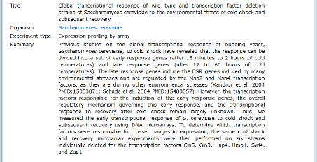
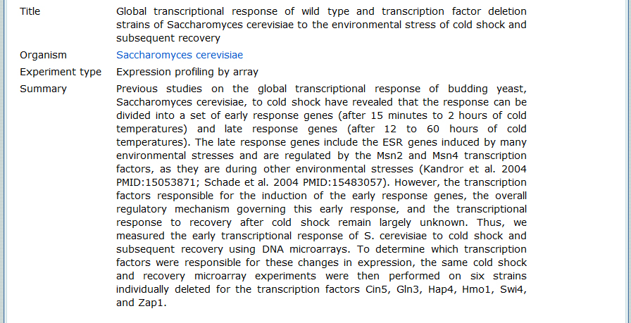
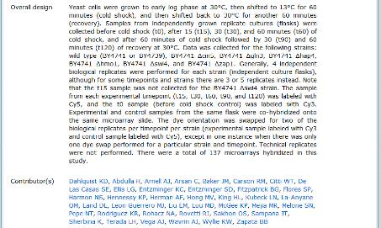
Microarray Data Have Been Collected for 6 Transcription Factor Deletion Strains

Slide 12
GRNmap: Gene Regulatory Network Modeling and Parameter Estimation
The change in expression of one gene is production – degradation.
Weight parameter, w, gives the direction (activation or repression) and magnitude of regulatory relationship.
Differential equation models are fit to experimental data using a penalized least squares approach.
http://kdahlquist.github.io/GRNmap/

Slide 13
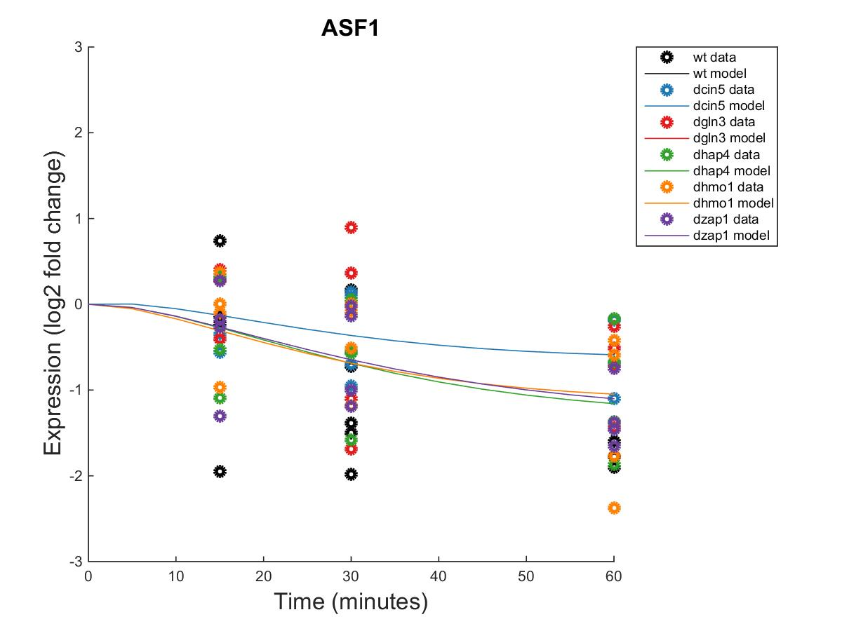
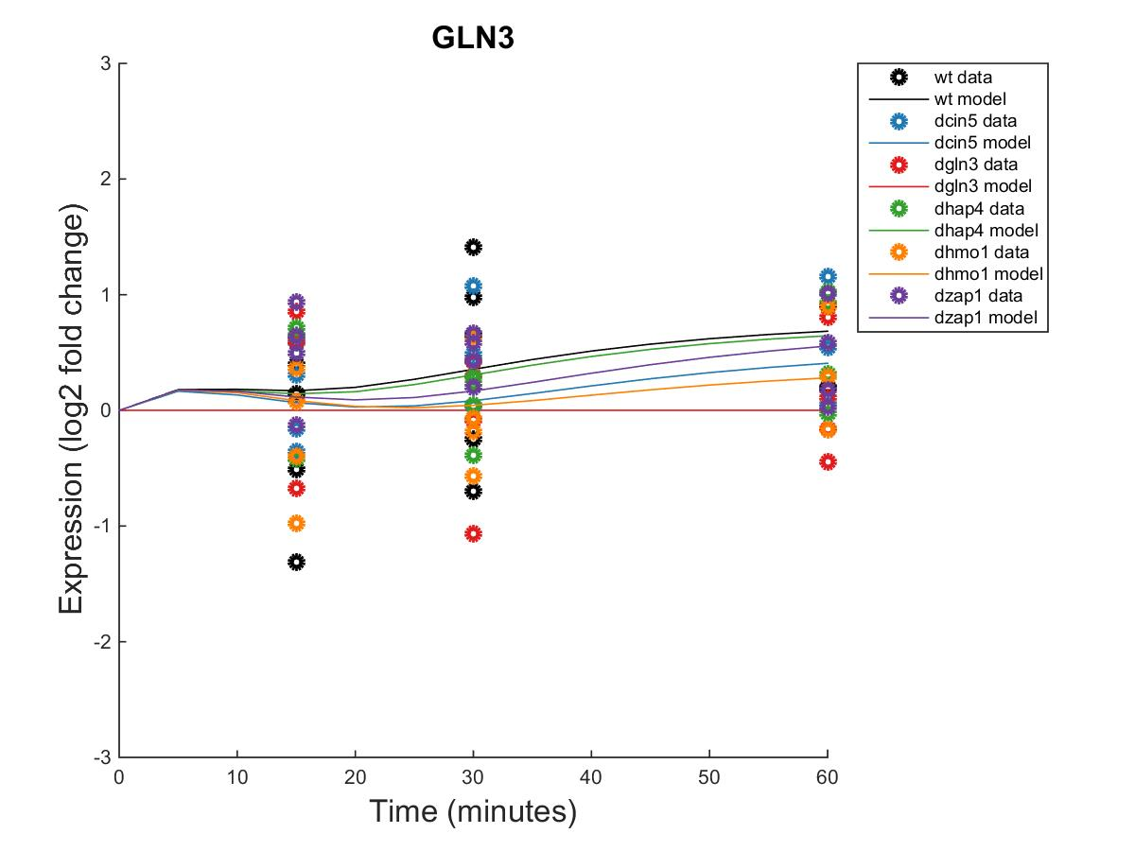
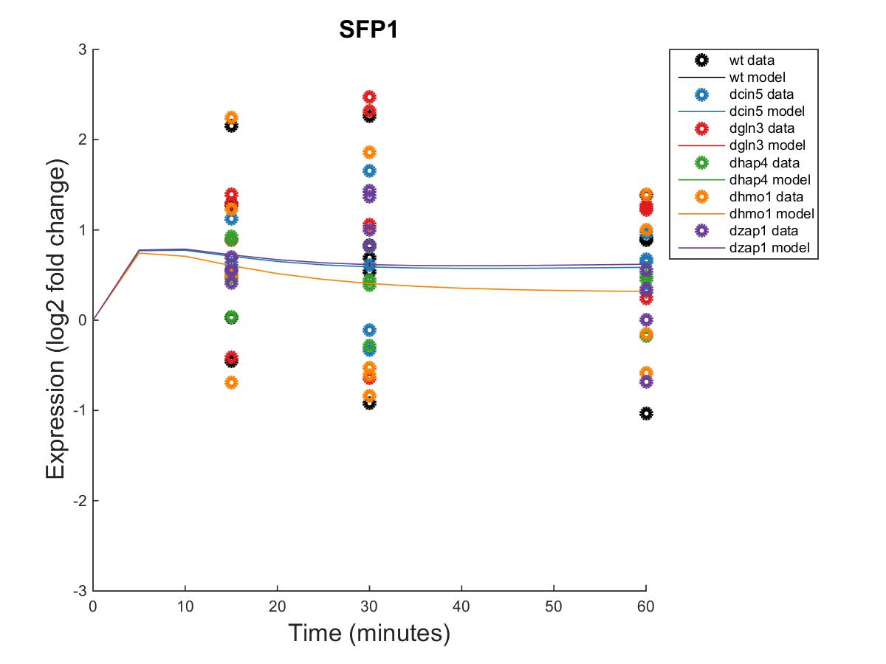
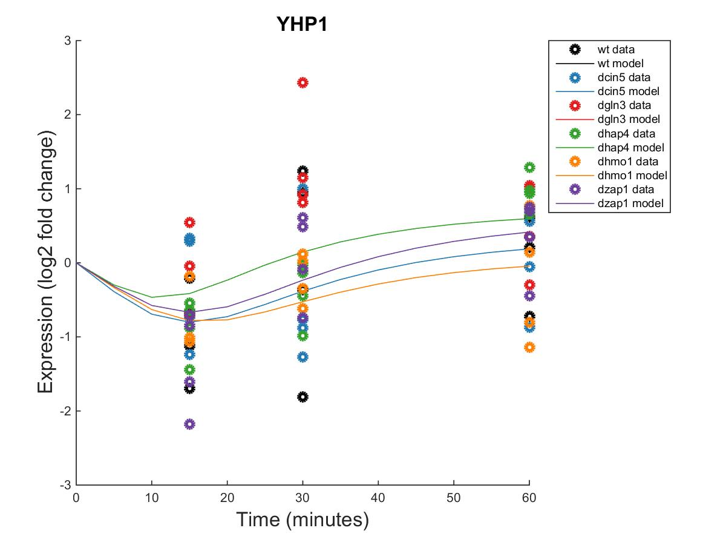
Forward Simulation of the Models Fits the Microarray Data Well
Within Strain ANOVA
0.0298
0.4193
0.4165
0.2305
0.8447
0.1669
Within Strain ANOVA
0.4189
0.5468
0.6094
0.5189
0.9281
0.1171
_{MSE:minMSE = 0.3695}
_{MSE:minMSE = 0.2209}
Within Strain ANOVA
0.4097
0.0494
0.0751
0.0533
0.8354
0.0021
Within Strain ANOVA
0.1743
0.8684
0.0433
0.0084
0.8152
0.0653
_{MSE:minMSE = 0.5337}
_{MSE:minMSE = 0.3662}
Notes:
Figure 2. Forward simulation of the wild-type derived network in GRNmap accurately modeled common expression profiles. Within-strain ANOVA p-values are overlain onto the expression plots automatically output by GRNmap, with color coding indicating individual strains from which input data was derived. MSE:minMSE ratio values averaged across all six strains are also reported, indicating the goodness-of-fit of the model data (lines) to the actual expression of each gene (circles).

Slide 14
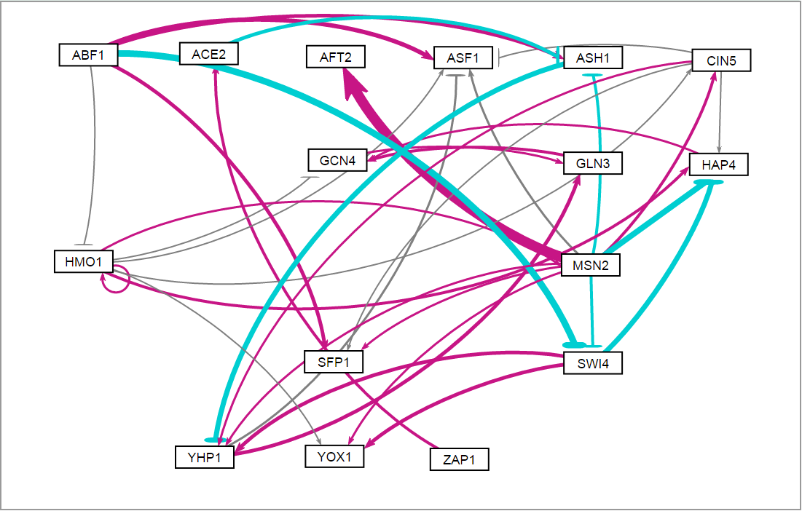
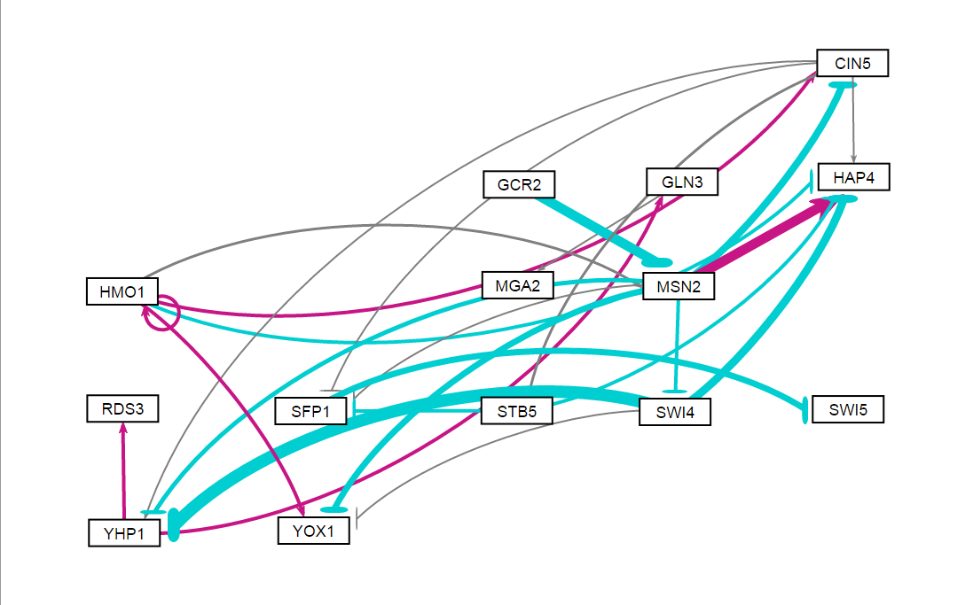
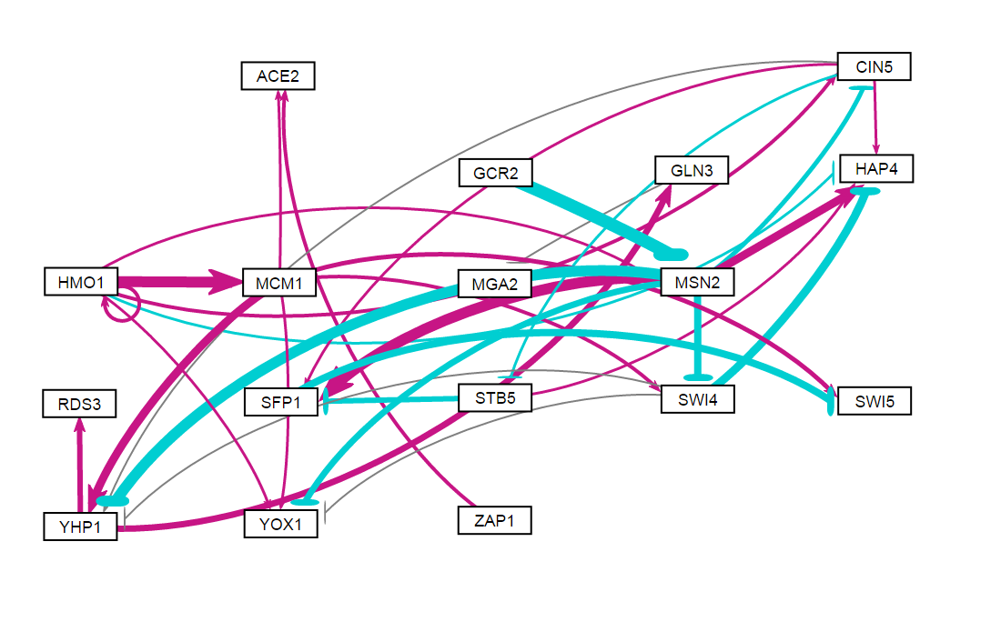
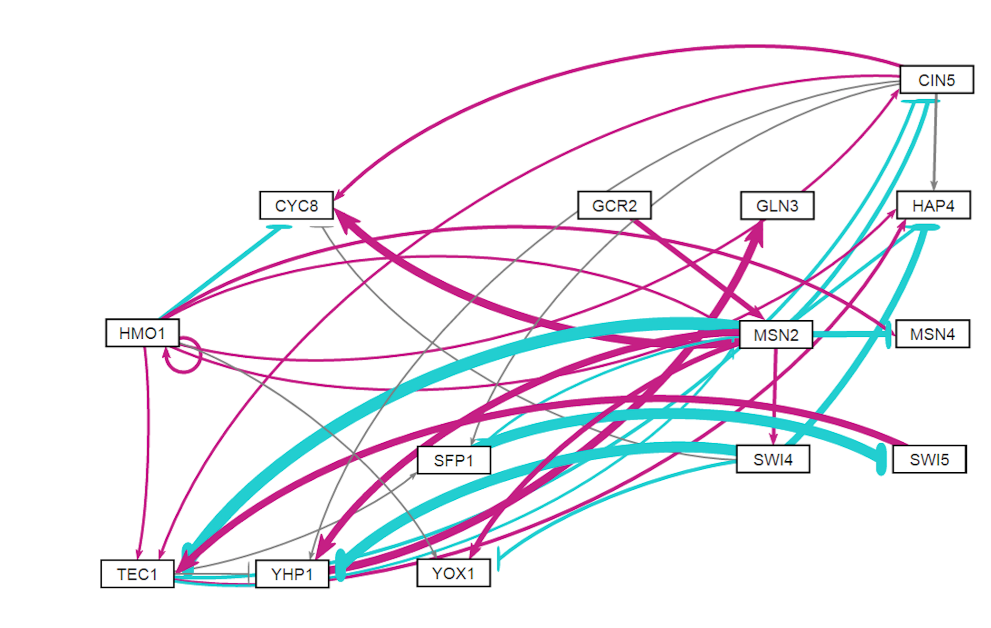
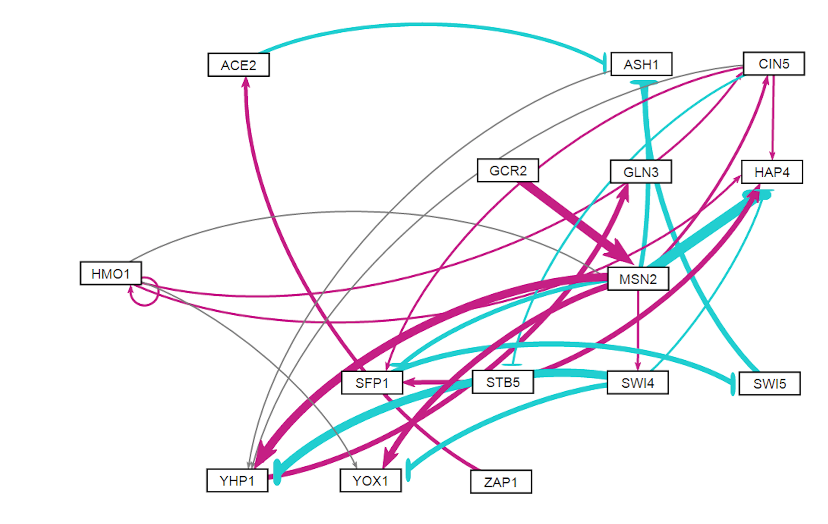
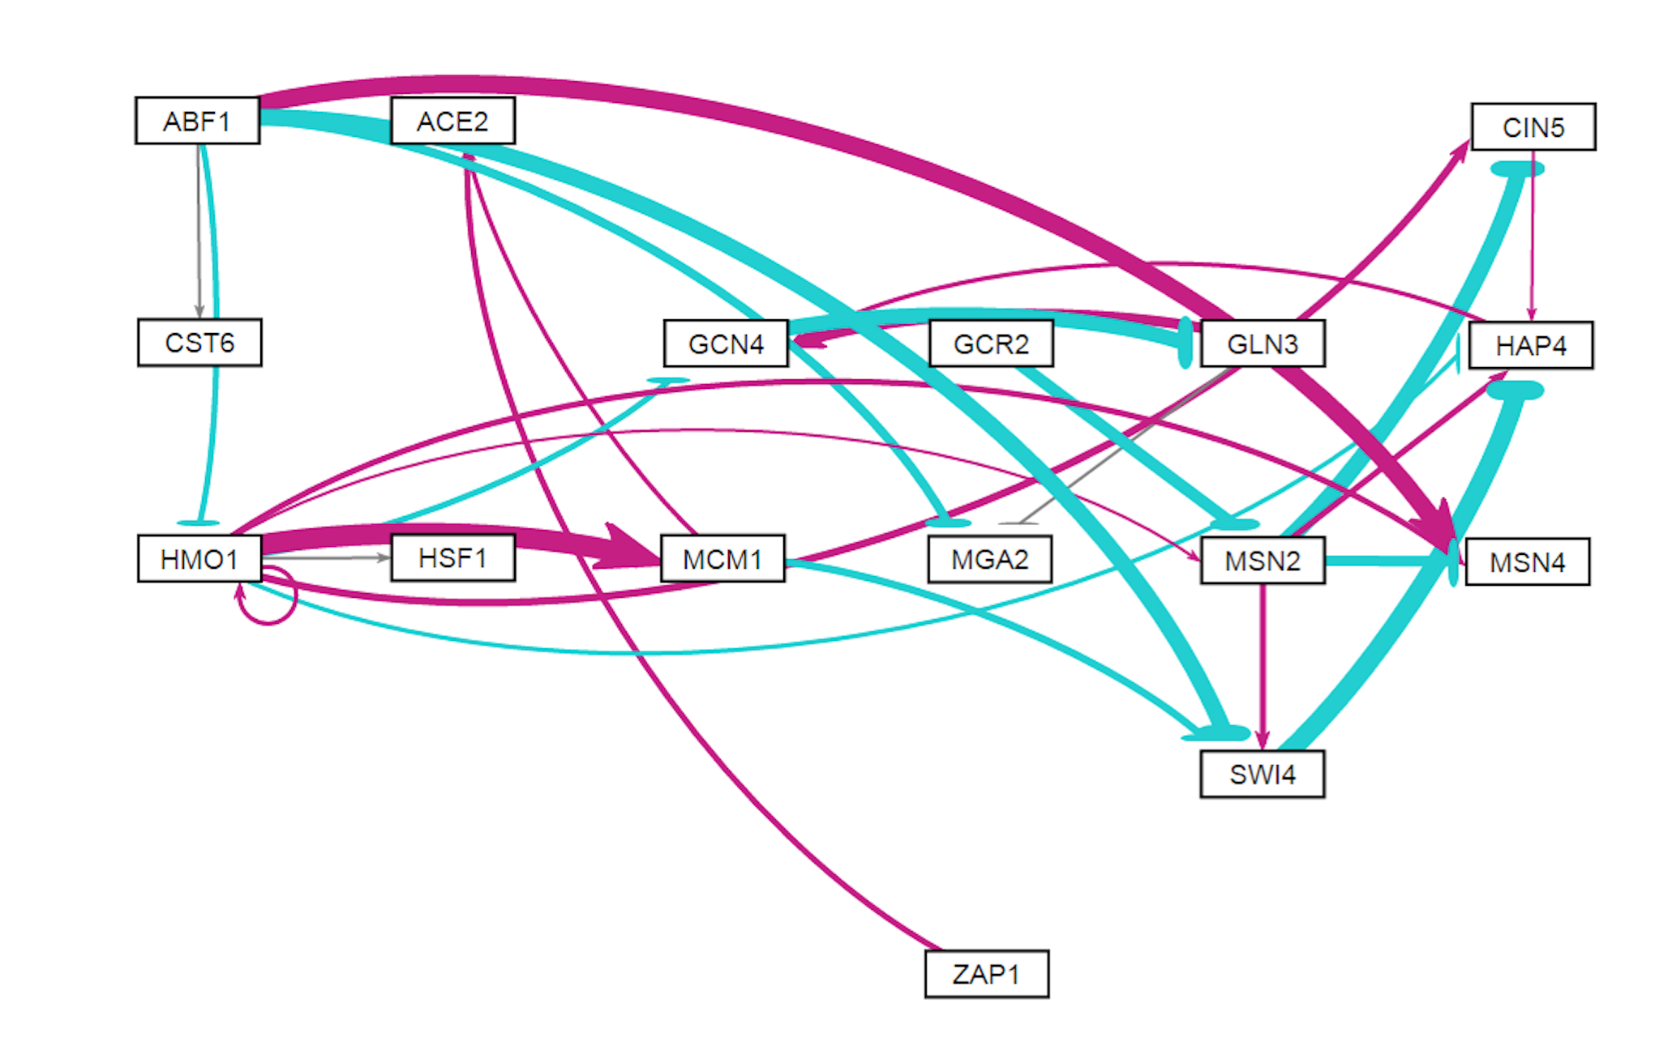
Six Related Gene Regulatory Networks were Derived from Cold Shock Microarray Data
db1 (wt): 16 Genes, 26 Edges
LSE:minLSE = 1.42
db2 (∆cin5): 14 Genes, 25 Edges
LSE:minLSE = 1.36
db3 (∆cin5): 17 Genes, 32 Edges
LSE:minLSE = 1.41
db4 (∆hap4): 14 Genes, 35 Edges
LSE:minLSE = 1.30
db5 (∆gln3): 15 Genes, 28 Edges
LSE:minLSE = 1.43
db6 (∆zap1): 16 Genes, 27 Edges
LSE:minLSE = 1.40
Notes:
Figure 4. GRNsight visualization highlights salient features of db1-db6. Transcription factors are represented by boxes and arranged in a consistent array. Regulatory relationships are represented by arrows directed from regulator to target. Pointed arrowheads and magenta coloration indicate activation, whereas flat arrowheads and cyan coloration indicate repression. Edges colored in grey exhibit small influence, meaning their associated weights are <5% of the maximum edge weight in the network.
Enlarge images of networks, present 2 per row, or rotate CCW 90 degrees.

Slide 15
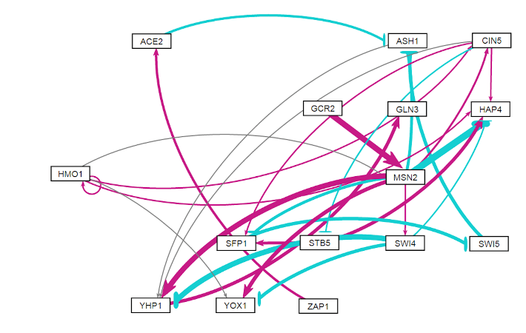
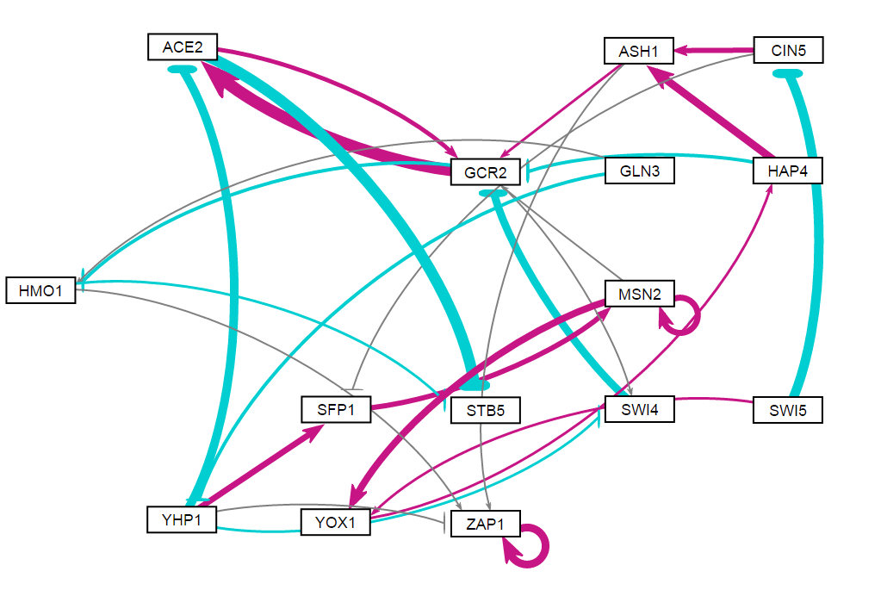
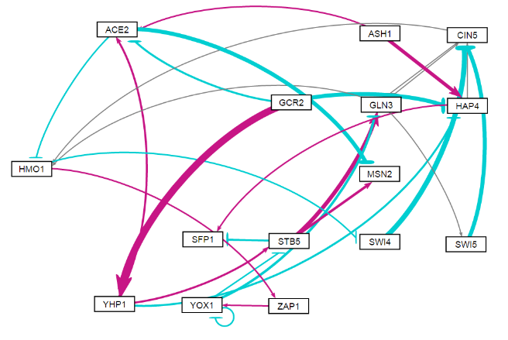
Db5 Outperforms 30 Random Networks Containing the Same Genes and Numbers of Edges
Ratio of the Observed Least Squares Error to the Minimum Theoretical Least Squares Error
db5
rand24
rand7
Notes:
Figure 8. The network derived from ∆hap4 strain data, db5, generally outperformed 30 random networks composed of the same transcription factors and containing the same number of edges. The LSE:minLSE ratios for db1-db6 are reported on the left and for the thirty random networks on the right. The arrows indicate the bars corresponding to db5 (black), the three best performing random networks (green), and the three worst performing random networks (purple). A horizontal line is drawn demarcating the LSE:minLSE ratio of db5 for comparison.

Slide 16
In General, Random Networks that Share More Connections with db5 Perform Better
Horizontal Line: LSE:minLSE ratio of db5 (1.4263).
Vertical Line: median number of regulatory relationships shared with db5 (2).
Notes:
Figure 9. LSE:minLSE Ratio of Random Networks vs. # of Regulatory Relationships Shared with db5. The vertical line indicated the median number of regulatory relationships shared with db5 (2). The horizontal line marks the LSE:minLSE ratio of db5 (1.4263).
Q4 is conspicuously empty (except for point where x=7), whereas Q3 contains several points. However, in Q1 & Q2, points appear to slope downwards.
Suggests that for networks that performed worse than db5, having common edges tended to boost performance. However, to exceed db5, rewiring of the network was required.

Slide 17
Multiple Regression Analyses Identified Determinants of Individual Transcription Factor Model Fits
 | Database-Derived Networks |  |  |  |  |  |  | 3 Best Random Networks |  |  |  | 3 Worst Random Networks
 | db1 | db2 | db3 | db4 | db5 | db6 |  | rand15 | rand16 | rand24 |  | rand7 | rand12 | rand31
ANOVA B&H p-value
Average Expression at 15 min. | -0.507 | -0.624 | -0.479 | -0.552 | -0.528 | -0.626 |  |  |  |  |  | -0.838 |  | -0.656
Average Expression at 30 min.
Average Expression at 60 min. |  |  |  |  |  |  |  |  |  |  |  |  | -0.503
Degradation Rate |  |  |  |  |  |  |  | -0.505 |  | -0.611
Optimized Production Rate | 0.578 |  |  | 0.777 |  | 0.437
Optimized Threshold b |  |  |  | 0.883
Weighted In-degree |  |  |  |  |  | 0.617
Weighted Out-degree |  |  |  |  |  |  |  | -0.627 |  |  |  | 0.433
Eccentricity
Closeness Centrality |  |  |  |  |  |  |  | -0.443
Betweenness Centrality |  |  |  |  |  |  |  |  | -0.609 |  |  | 0.399
Clustering |  | 0.522 | 0.473 |  | 0.501
Eigenvector Centrality | -0.384 |  |  | -0.533 |  | -0.328 |  |  |  | -0.598 |  |  | -0.685 | -0.831
Modularity Class | — | — | — | — | — | — |  |  |  |  |  |  | 0.510
Page Ranks | — | — | — | — | — | — |  |  |  |  |  |  |  | 0.633
Strong Component Number | — | — | — | — | — | — |  |  | 0.633 |  |  |  | -1.033
Adjusted R² | 0.290 | 0.525 | 0.360 | 0.441 | 0.350 | 0.196 |  | 0.436 | 0.552 | 0.257 |  | 0.500 | 0.692 | 0.437
Factors that were not significant predictors of MSE:minMSE ratio: ANOVA B&H p-value, Average Expression at 30 minutes, Eccentricity
Factors that were consistently significant predictors of MSE:minMSE ratio: Average Expression at 15 minutes, Eigenvector Centrality
Notes:
Figure 9. LSE:minLSE Ratio of Random Networks vs. # of Regulatory Relationships Shared with db5. The vertical line indicated the median number of regulatory relationships shared with db5 (2). The horizontal line marks the LSE:minLSE ratio of db5 (1.4263).

Slide 18
Outline
Yeast quickly respond to cold shock by changing gene expression, although the transcription factors regulating this cold response have not been established.
GRNmap successfully models gene regulatory network parameters from microarray data using differential equations.
Comparative analysis of six database-derived networks reveals conserved properties of the network controlling the cold shock response in yeast.

Slide 19
Modeling Revealed Consistent Regulatory Relationships Among Sets of Transcription Factors
 | db1 | db2 | db3 | db4 | db5 | db6 |  | db1 | db2 | db3 | db4 | db5 | db6
ABF1->ASF1 |  |  |  |  |  |  | MCM1->SWI4
ABF1->ASH1 |  |  |  |  |  |  | MCM1->SWI5
ABF1->CST6 |  |  |  |  |  |  | MCM1->YHP1
ABF1->HMO1 |  |  |  |  |  |  | MCM1->YOX1
ABF1->MGA2 |  |  |  |  |  |  | MSN2->AFT2
ABF1->MSN4 |  |  |  |  |  |  | MSN2->ASF1
ABF1->SFP1 |  |  |  |  |  |  | MSN2->ASH1
ABF1->SWI4 |  |  |  |  |  |  | MSN2->CIN5
ACE2->ASH1 |  |  |  |  |  |  | MSN2->CYC8
ASH1->YHP1 |  |  |  |  |  |  | MSN2->HAP4
CIN5->ASF1 |  |  |  |  |  |  | MSN2->MSN4
CIN5->CYC8 |  |  |  |  |  |  | MSN2->SFP1
CIN5->HAP4 |  |  |  |  |  |  | MSN2->SWI4
CIN5->SFP1 |  |  |  |  |  |  | MSN2->TEC1
CIN5->STB5 |  |  |  |  |  |  | MSN2->YHP1
CIN5->TEC1 |  |  |  |  |  |  | MSN2->YOX1
CIN5->YHP1 |  |  |  |  |  |  | SFP1->SWI5
GCN4->GLN3 |  |  |  |  |  |  | STB5->HAP4
GLN3->GCN4 |  |  |  |  |  |  | STB5->SFP1
GLN3->MGA2 |  |  |  |  |  |  | SWI4->CYC8
GCR2->MSN2 |  |  |  |  |  |  | SWI4->HAP4
HAP4->GCN4 |  |  |  |  |  |  | SWI4->YHP1
HMO1->ASF1 |  |  |  |  |  |  | SWI4->YOX1
HMO1->CIN5 |  |  |  |  |  |  | SWI5->ASH1
HMO1->CYC8 |  |  |  |  |  |  | SWI5->TEC1
HMO1->GCN4 |  |  |  |  |  |  | TEC1->CIN5
HMO1->HAP4 |  |  |  |  |  |  | TEC1->HAP4
HMO1->HMO1 |  |  |  |  |  |  | TEC1->MSN2
HMO1->HSF1 |  |  |  |  |  |  | TEC1->SFP1
HMO1->MCM1 |  |  |  |  |  |  | TEC1->YHP1
HMO1->MSN2 |  |  |  |  |  |  | YHP1->ASF1
HMO1->MSN4 |  |  |  |  |  |  | YHP1->GLN3
HMO1->TEC1 |  |  |  |  |  |  | YHP1->RDS3
HMO1->YOX1 |  |  |  |  |  |  | ZAP1->ACE2
MCM1->ACE2
Maximum: 1
Minimum : -1
Notes:
Table 5. Heat map visualizing regulatory weights for each of the sixty-nine edges represented in db1-db6. Positive weights are indicated by red and negative weights by blue. Darker shades correspond to higher magnitude weights. All values were normalized to the largest magnitude weight, MSN2→AFT2, in db1.

Slide 20
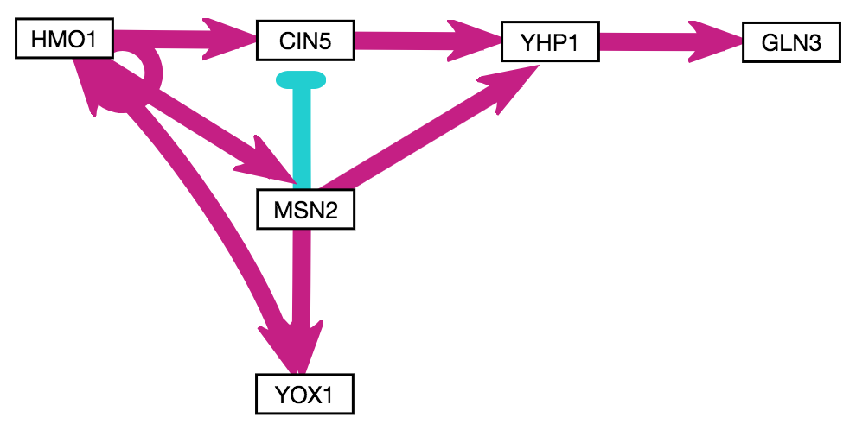
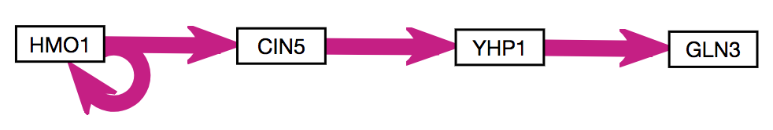
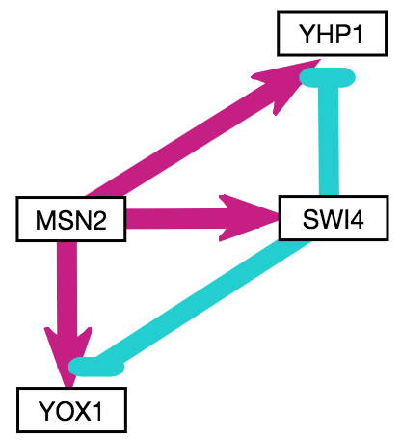
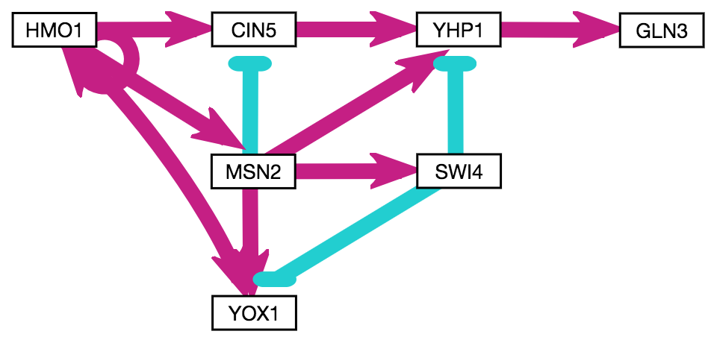
Motifs Conserved in the Database-Derived Networks were Identified
A
B
C
D
Regulator Chains &
5 Feedforward Loops
Notes:
Figure 6. Conserved motifs in the six database-derived GRNs include regulatory chains and feedforward loops (FFLs). A regulatory chain comprised of HMO1, CIN5, YHP1, and GLN3 exhibited consistent activation in five GRNs (A). Addition of MSN2, YOX1, and their associated edges (which were weighted based on frequency) to the regulatory chain yielded a system of 3 FFLs (B). MSN2 also forms symmetrical FFLs mediated by SWI4 that terminate on the paralogs YHP1 and YOX1, which most frequently appear as incoherent type 1 FFLs (C). Addition of the described motifs (A-C) yields a conserved system containing 5 FFLs and a regulatory chain (D). Boxes indicate genes and arrows indicate edges, with pointed arrowheads representing activation (magenta) and flat arrowheads repression (cyan).

Slide 21
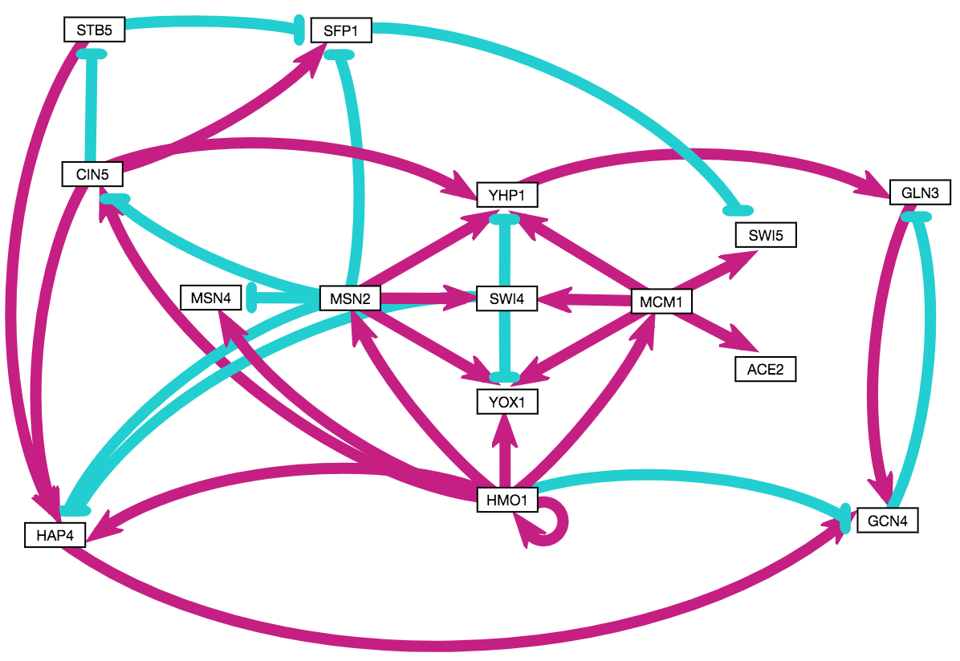
A Hypothesis Network was Constructed from Conserved Motifs and High Eigenvector Centrality Genes
The hypothesis network contains 15 genes and 34 edges.
Notes:
15 genes, 34 edges (highly connected; most similar to db4 in this respect, which had lowest LSE:minLSE ratio but also included TEC1).
Colored pairs = paralogs.
Orange borders = known cold-sensitive phenotypes on SGD.
Green borders = tested by Dahlquist lab.
Light grey shading = appears distinct from ESR (not MSN2/4 mediated).
GCN4 has eigen of 1 in both nSFP1 in 5/6 networks + high eigen + consistent repression of SWI5.
etworks where it appears… connects disparate “modules” and created negative feedback loop.
Nodes that did not make it: TEC1 (highly connected, but 1 network), GCR2 (5/6, but negligible experimental expression ∆), CST6 (known cold phenotype, but only connected to ABF1, which is not in this GRN).

Slide 22
The Hypothesis Network Exhibits Similar Patterns of Paralog Signaling
ACE2/SWI5 and YHP1/YOX1 regulate the cell cycle.
MSN2/MSN4 regulate the environmental stress response.
Notes:
15 genes, 34 edges (highly connected; most similar to db4 in this respect, which had lowest LSE:minLSE ratio but also included TEC1).
Colored pairs = paralogs.
Orange borders = known cold-sensitive phenotypes on SGD.
Green borders = tested by Dahlquist lab.
Light grey shading = appears distinct from ESR (not MSN2/4 mediated).
GCN4 has eigen of 1 in both nSFP1 in 5/6 networks + high eigen + consistent repression of SWI5.
etworks where it appears… connects disparate “modules” and created negative feedback loop.
Nodes that did not make it: TEC1 (highly connected, but 1 network), GCR2 (5/6, but negligible experimental expression ∆), CST6 (known cold phenotype, but only connected to ABF1, which is not in this GRN).

Slide 23
The Hypothesis Network Exhibits Overlap with the Environmental Stress Response (ESR)
The ESR is MSN2/4-dependent but represses ribosome biogenesis.
HMO1 induces TORC1-dependent upregulation of ribosome biogenesis.
Notes:
15 genes, 34 edges (highly connected; most similar to db4 in this respect, which had lowest LSE:minLSE ratio but also included TEC1).
Colored pairs = paralogs.
Orange borders = known cold-sensitive phenotypes on SGD.
Green borders = tested by Dahlquist lab.
Light grey shading = appears distinct from ESR (not MSN2/4 mediated).
GCN4 has eigen of 1 in both SFP1 in 5/6 networks + high eigen + consistent repression of SWI5.
etworks where it appears… connects disparate “modules” and created negative feedback loop.
Nodes that did not make it: TEC1 (highly connected, but 1 network), GCR2 (5/6, but negligible experimental expression ∆), CST6 (known cold phenotype, but only connected to ABF1, which is not in this GRN).

Slide 24
Conclusions and Future Directions
Which transcription factors control the early response to cold shock?
Experimental and modeling results suggest Gln3, Hap4, Hmo1, and Swi4 play important roles.
Overlap with the MSN2/4-dependent ESR was observed.
What network motifs do these transcription factors form?
Conserved motifs include an activating regulatory chain initiated by Hmo1 and four symmetrical incoherent type I FFLs mediated by Swi4 that terminate on the paralogs Yhp1 and Yox1.
What are the indirect effects of other transcription factors in the gene regulatory network?
The model predicted Sfp1 (?) is involved. The ∆Sfp1 strain is cold sensitive, and we are now collecting microarray data.
Other promising targets for study include the viable double deletion strains ∆yhp1∆yox1 and ∆msn2∆msn4.

Slide 25

GRNsight: http://dondi.github.io/GRNsight/ GRNmap: http://kdahlquist.github.io/GRNmap/
Back row (left to right)
Brandon Klein
Mihir Samdarshi
Kevin McGee
Kevin Wyllie
K. Grace Johnson
Kristen Horstmann
Tessa Morris
Front row (left to right)
Maggie O’Neil
Monica Hong
Kam Dahlquist
Anindita Varshneya
Kayla Jackson
Not pictured
John David N. Dionisio
Ben G. Fitzpatrick
Nicole Anguiano
Juan Carrillo
Trixie Anne Roque
Chukwuemeka Azinge
Funding: NSF RUI, Kadner-Pitts Research Grant, LMU SURP,
LMU Honors Program, LMU Rains Research Assistant Program

